Slide 1
Bian Jiao
Yurara Hana Haruto

Slide 2

Overview
Who is Bian Jiao?
What does she do?
Key achievement
Why we choose this person
What makes them a good leader
conclusion

Slide 3
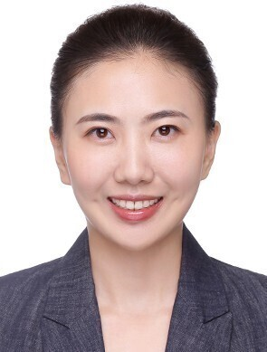
Who is Bian Jiao?
CEO of Puxiang Healthcare Group
Expert in integrated healthcare & eldercare
Master's degree from the University of Manchester
Selected as a Young Global Leader (World Economic Forum)

Slide 4

What do they do？
2014: Joined Puxiang Investment as Vice President
2019: Appointed Director of Puxiang Group
2025: Led Hong Kong IPO of Puxiang Health as CEO & Executive Director

Slide 5
Key achievement
Expanded healthcare + senior care business, increasing both facilities and revenue
Engaged in international & public activities, including the World Economic Forum

Slide 6

Why we chose this person?
She worked at Medical care center
Indicate our career

Slide 7
What makes her a good leader
①Strategic vision
②Executes plan effectively

Slide 8

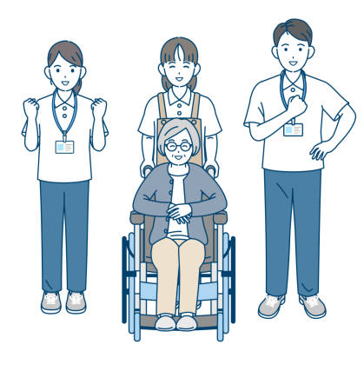

①Strategic vision
Medical care
Predicting the needs of an aging society
Nursing care

Slide 9

②Executing plan effectively
New medical institutions
By efficiently managing facilities
Turn a profit in about 15 months.
15months

Slide 10
Conclusion
Her leadership combines vision, execution, and globalthinking
Creates lasting impact on healthcare and society
Strong model of modern leadership

Slide 11
Thank you for lisning!

